Slide 1

A First View of Vue.js
By: Vince Bullinger
Open Source North
6/8/2017

Slide 2
About Me
Vince Bullinger (“vbullinger” everywhere)
Live in St. Paul
WPI grad (‘04)
Been a consultant/developer since 2005
Always looking to improve skills

Slide 3


About Me
Married in 5/08
Zina 7/4/11, Felix 7/8/14, Leo 1/17/16

Slide 4


Slide 5
Agenda
What is Vue?
Looking under the hood
In-depth Vue
Peruse the ecosystem
Who is using it?
When should I use it?

Slide 6
Who Has Used Vue?

Slide 7
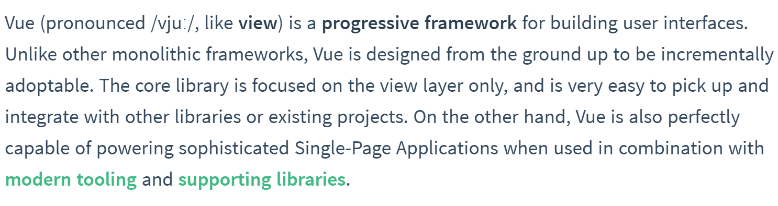
What is Vue?
Source: https://vuejs.org/v2/guide/

Slide 8
Why Another JavaScript Framework?
Major frameworks have haters
React is unintuitive for many
Angular isn’t as performant as React
Vue combines best of Angular, React
Friendly, MVVM, two-way binding syntax of Angular, Knockout, XAML
Virtual DOM of React

Slide 9
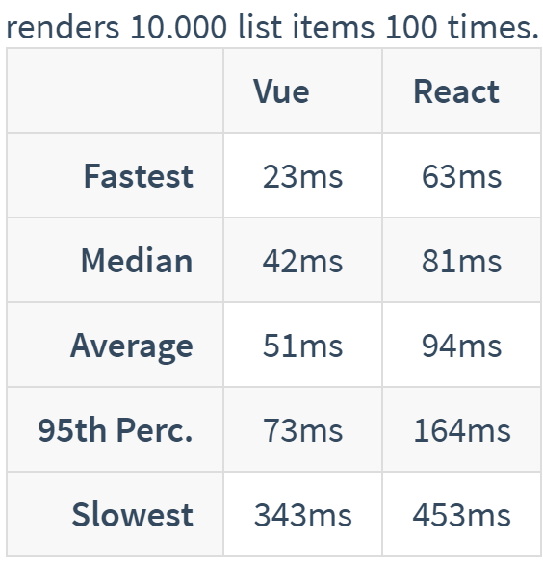
How Does It Compare?
React
Virtual DOM
Focus on view layer
Angular
2-way data-binding
MV* syntax
Not comparable in speed
Source: https://vuejs.org/v2/guide/comparison.html
Comprehensive table: http://stefankrause.net/js-frameworks-benchmark4/webdriver-ts/table.html

Slide 10
Getting Started, 101 Demo

Slide 11
Under the Hood
Virtual DOM
Vue lifecycle

Slide 12
The Virtual DOM

Slide 13

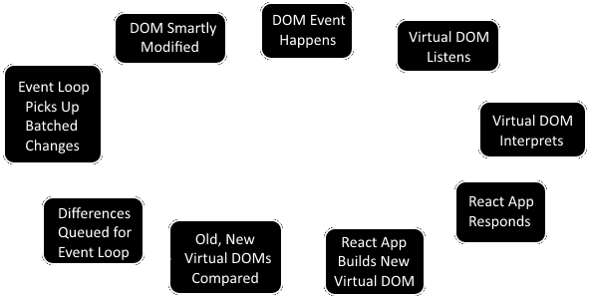
Virtual DOM

Slide 14
The Vue Lifecycle

Slide 15
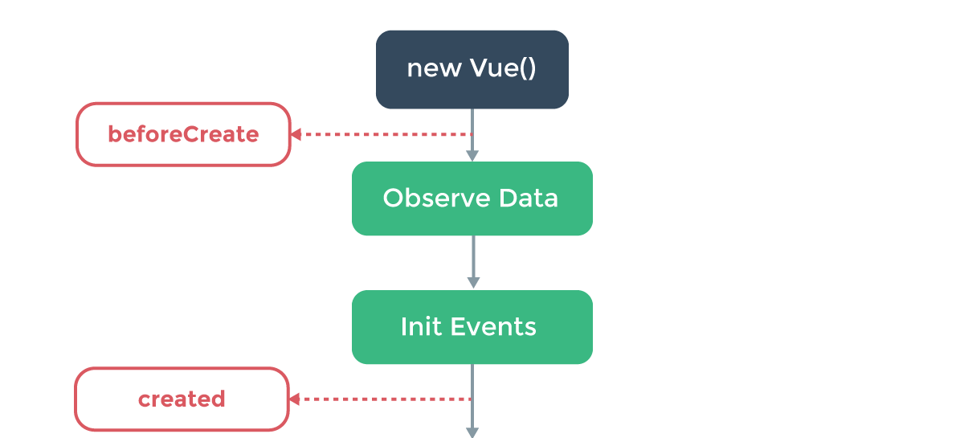
Creation
Source: https://vuejs.org/v2/guide/

Slide 16
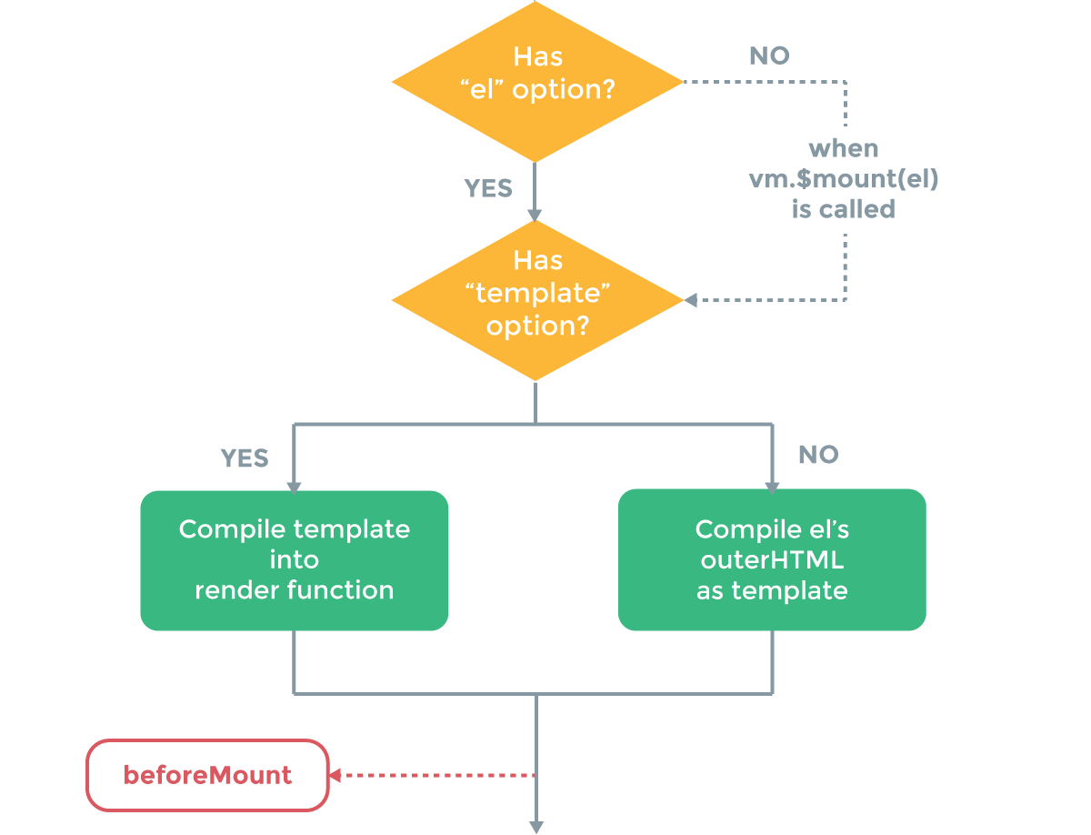
Compilation
Source: https://vuejs.org/v2/guide/

Slide 17
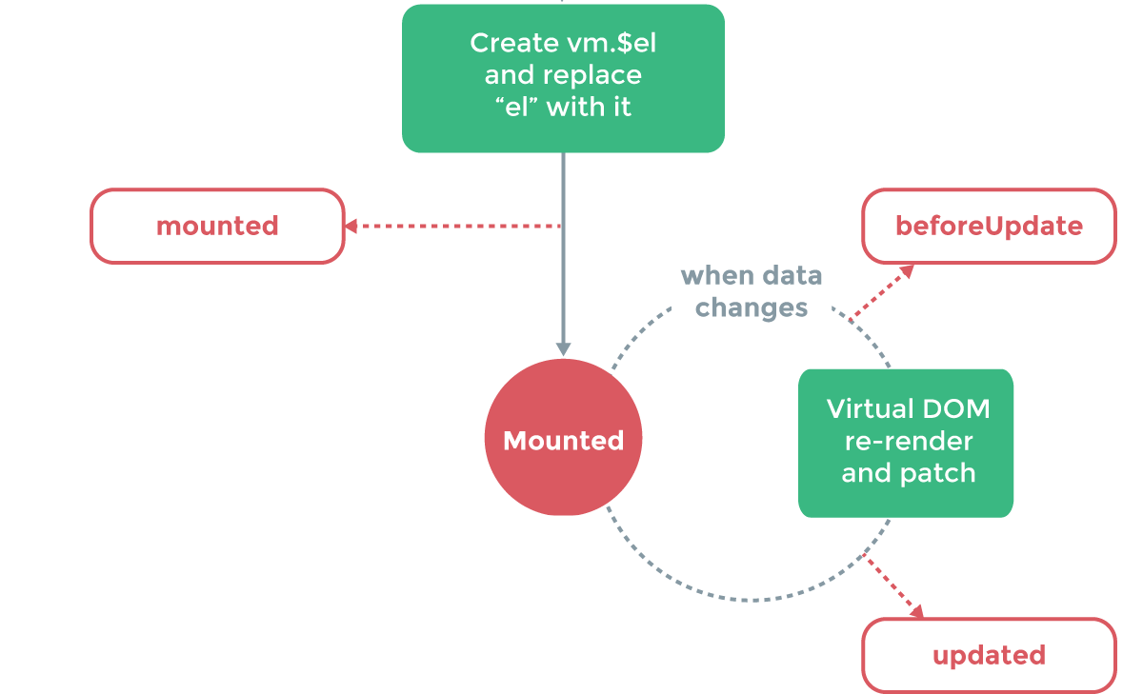
Rendering
Source: https://vuejs.org/v2/guide/

Slide 18
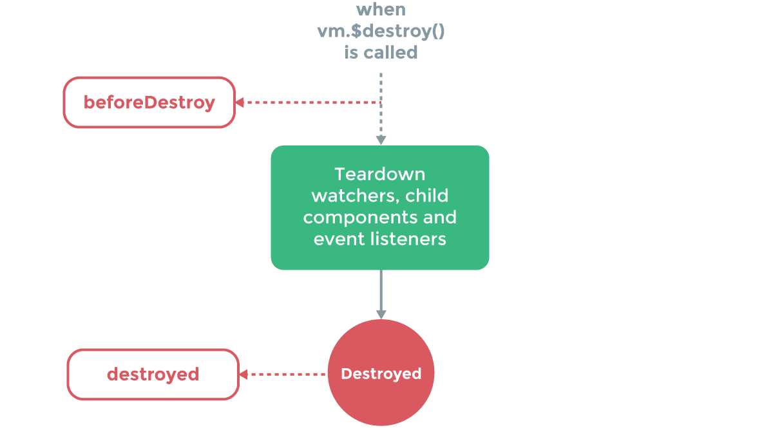
Destruction
Source: https://vuejs.org/v2/guide/

Slide 19
Vue Templates Deep-Dive

Slide 20
Templates Topics
One-time binding
Raw HTML
Attribute binding
Conditionals
Loops
Events
Modifiers
Filters

Slide 21
How Vue Templates Work
Declaratively bind HTML to DOM
Valid HTML
Compiles to virtual DOM “render” function

Slide 22
Templates Demo

Slide 23
Templates Recap
One-time binding
Raw HTML
Attribute binding
Conditionals
Loops
Events
Modifiers
Filters

Slide 24
Vue Routing Deep-Dive

Slide 25
Routing Topics
Parameters
Events
Nested routes
JavaScript routing

Slide 26
Routing Demos

Slide 27
Routing Recap
Parameters
Events
Nested routes
JavaScript routing

Slide 28
Vue State Management Overview

Slide 29
State Management Topics
Vuex
State
Mutations
Actions
Modules

Slide 30
Vuex
Official state management system for Vue
Very flux-y
Very Redux-y

Slide 31
State
Data for app
No, really like: all of it (or at least most of it)
Singleton used across app (“store”)

Slide 32
Mutations
Collection of methods in store
Only way to change state
They have two parts:
Types
Handlers
To invoke: store.commit(‘typename’, payload)

Slide 33
Actions
Collection of methods in store
Commit mutations
Asynchronous stuff goes here
Invoked by store.dispatch(‘actionname’, payload)

Slide 34
Modules
Segments of a store
Can have separate:
Mutations
Actions
State

Slide 35
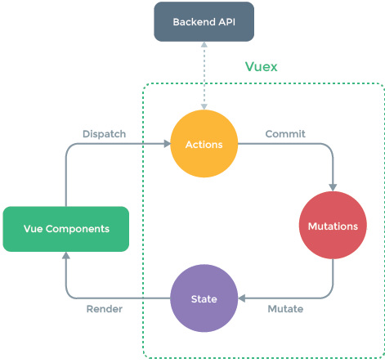
Vuex Visualized

Slide 36
State Management Recap
Vuex
State
Mutations
Actions
Modules

Slide 37
Who Is Using Vue?
https://github.com/vuejs/awesome-vue#projects-using-vuejs

Slide 38
When Should I Use Vue?
You like Angular’s syntax
You like React’s performance
You have a site that has visual updates
You’re willing to try something new
Maybe not the best for most extreme enterprise development right at the moment, but keep watching!

Slide 39
References - Time to Ask Softballs
Vue docs: https://vuejs.org/v2/guide/
Vuex: http://vuex.vuejs.org/en/
Chrome extension for debugging Vue apps: https://github.com/vuejs/vue-devtools
This slide deck: http://bit.ly/FirstViewOfVue
Awful Github repo: https://github.com/vbullinger/HelloVue

